Slide 1
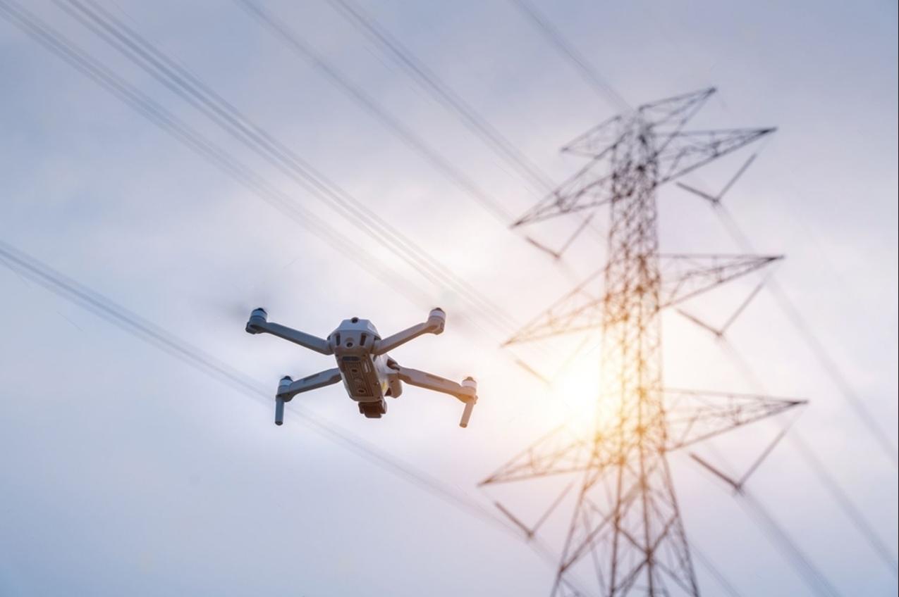
UAV-Based Powerline Problem Inspection and Classification using
Machine Learning Approaches
By:
Mahavir Chandaliya
Teja Sree Goli
Swapna Kotha
Advisor:
Prof. Jerry Gao

Slide 2
Presentation Outline
Introduction
UAVs and Powerlines Market Research
Intelligent Powerline Inspection Requirements and Applications
Intelligent Powerline Inspection Architecture
Data Collection
Model Training
Results Statistics
Demo
Conclusion and Future Scope

Slide 3
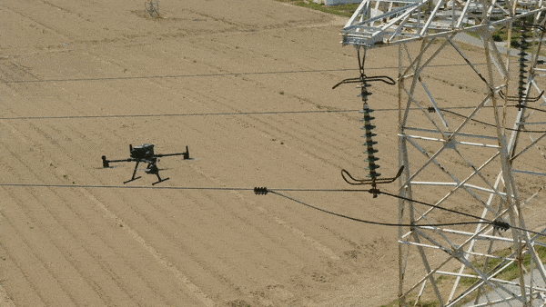
Introduction
The application utilizes UAV Drone videos of Powerlines to detect Powerline components and faults using various deep learning models.
The aim of the project is to minimize manual inspection of powerline by assisting with the deep learning based application using Drone captured videos.
The developed deep learning models accurately detects Powerline components like Towers, insulators, Cables etc. as well as the faults such as Broken components and presence of Vegetation.

Slide 4
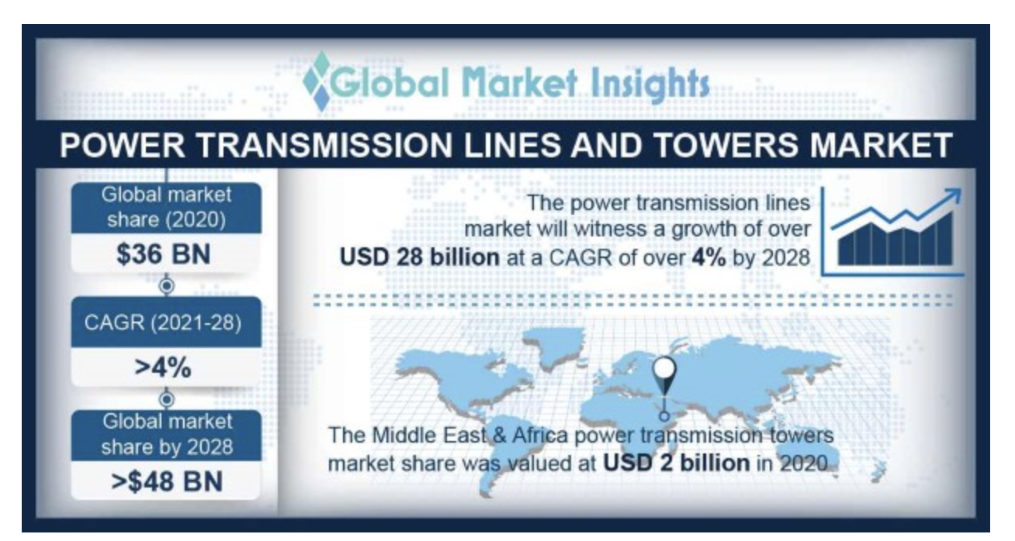
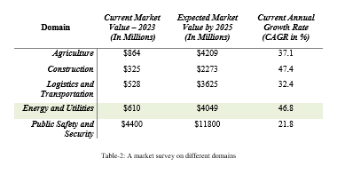
UAVs and Powerlines Market Research
The global market share for the powerlines industry is expected to grow up to >$48 Billions by 2028
With use of UAVs and Machine Learning in Energy domain, the global market share is predicted to have an annual growth rate of 46.8%.

Slide 5
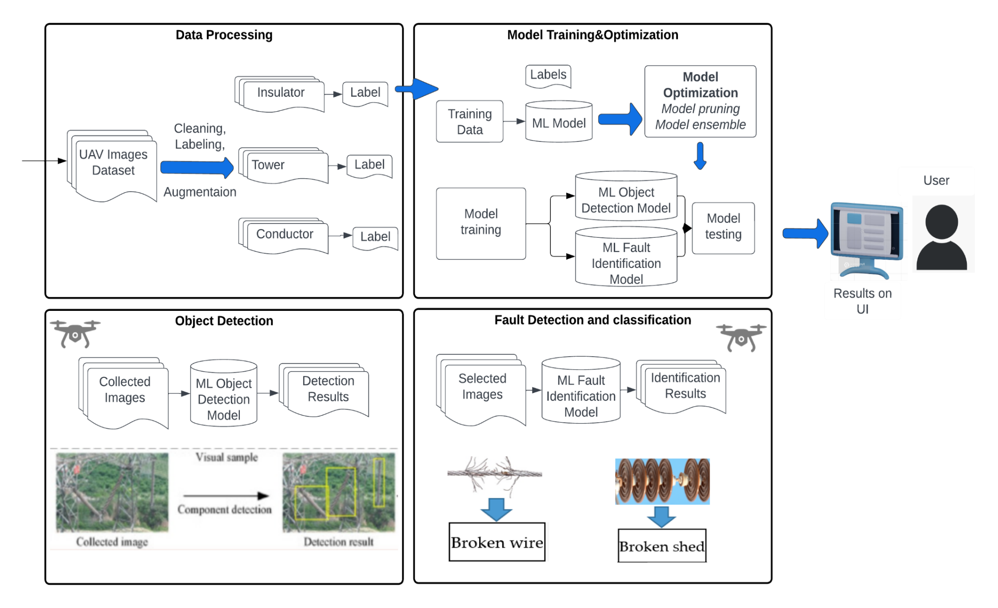
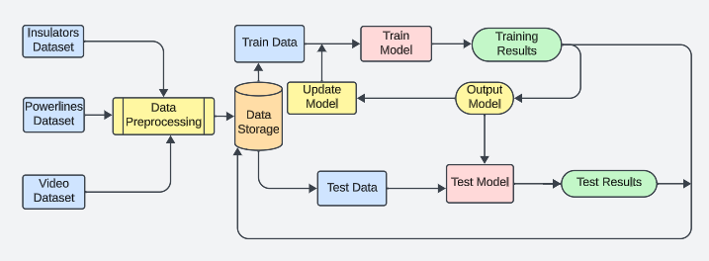
Intelligent Powerline Inspection Architecture
The data collected from various sources is manually labelled and further processed to feed to the deep learning model for object detection. Data Processing involves steps like resizing the image, data augmentation, etc.
The developed model is trained to detect Powerline Components and further trained to detect faults present in the components and classify them.

Slide 6
Data
Data Source: Data is collected from various open-source projects as well as real data collected using Drone captured videos.
Annotations: Images are manually annotated on Roboflow framework. Labels include Towers, Insulators, Broken components, Vegetation etc.
Data Pre-Processing: The image is resized to 640x640.
Data Augmentation: The images are further augmented by changing brightness, adding noise, greyscale images and by applying Mosaic data augmentation, which crops and joins various images together to generate a new image. Data augmentation increases the dataset for better model performance.

Slide 7
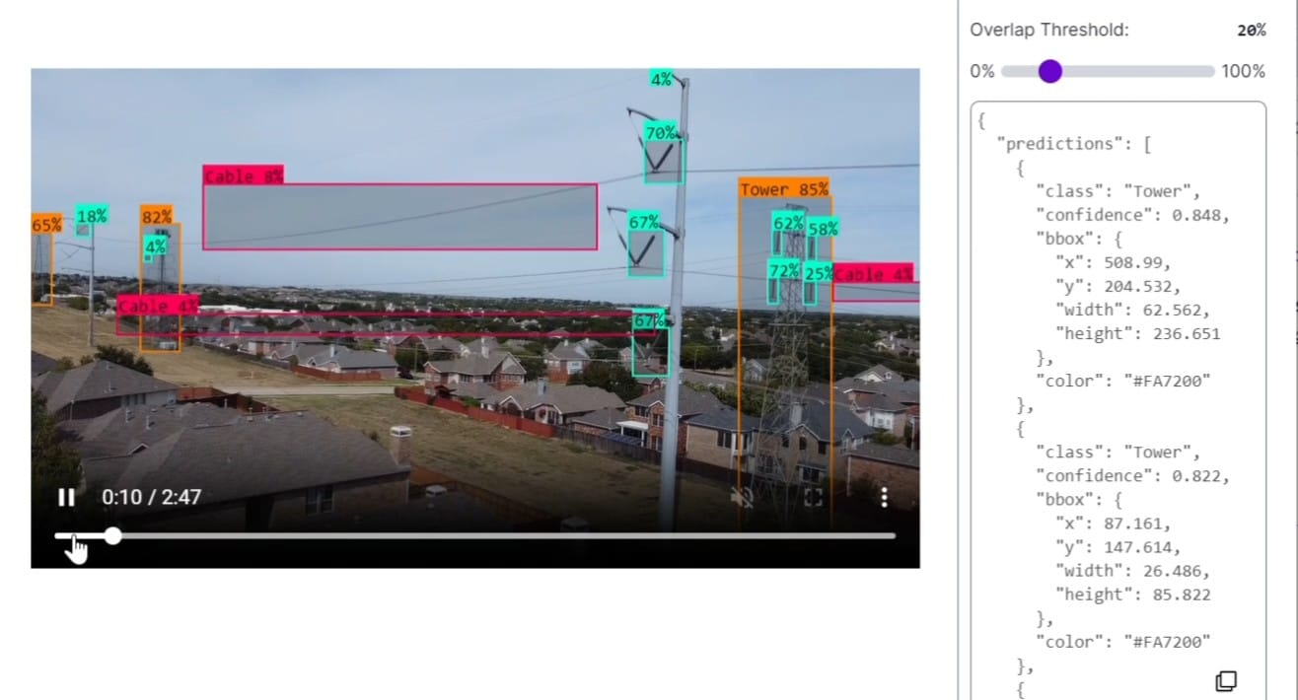
Model Training
We trained various deep learning models on the dataset such as Yolov8, COCO and other YOLO versions.
Roboflow is used for labelling and formatting the data and re-trained the model for object detection and fault detection.
By further fine-tuning the model, cleaning the dataset and optimizing model parameters to achieve high accuracy and F1-score.

Slide 8
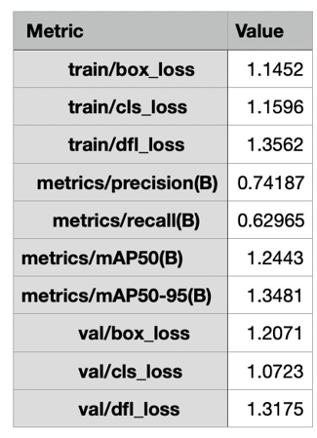
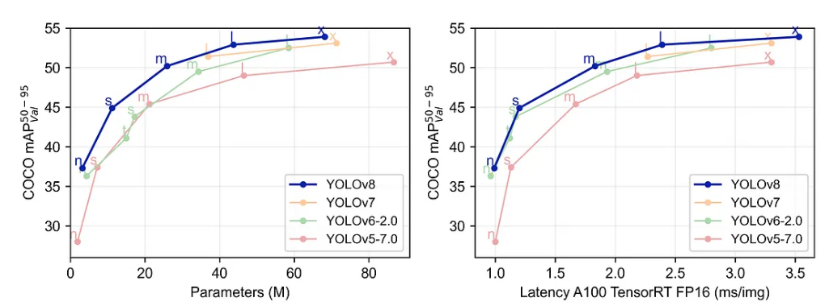
Results Statistics
Yolov8 performs significantly better than other YOLO versions in performance and accuracy.

Slide 9
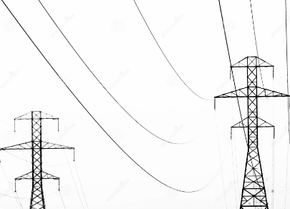
Future Scope
Collect more historical fault data to scale the project.
Integrate the model with UAV and conduct real-time powerline inspection.
Collaborate with energy firms to add more features to the model and analysis.

Slide 10
THANK YOU!

